Slide 1

Sistema de monitorização e rastreamento para gamification de operação turística - Ruralia
Group 6
Alberto Oliveira
Eduarda Aires
Beatriz Agante
Miguel Gomes
Pedro Azevedo
Ruben Lopes
Mentors
Daniel Corujo
Pedro Gonçalves
PECI - 2023/2024

Slide 2
Table of contents
01
02
03
04
05
06
Context
Motivation and Goals
State of the art
System Architecture
Development
Functionalities
07
08
09
Demonstration
Future Work
Conclusion

Slide 3
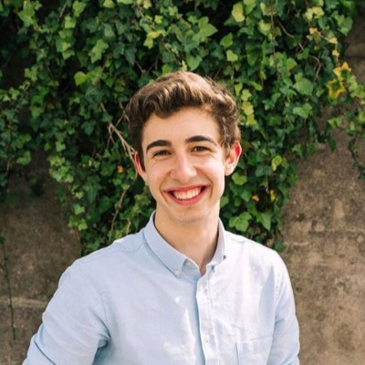
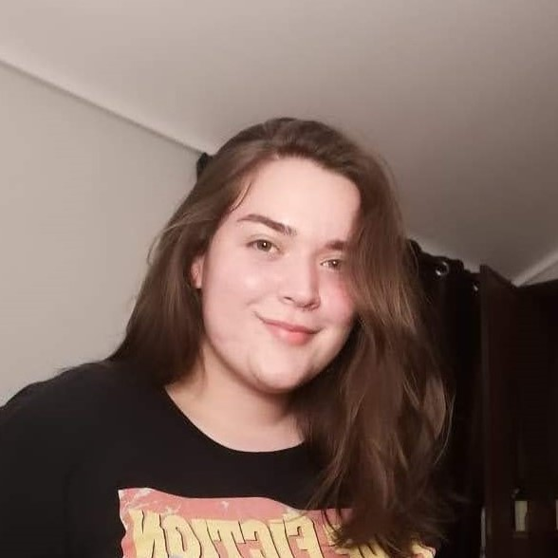
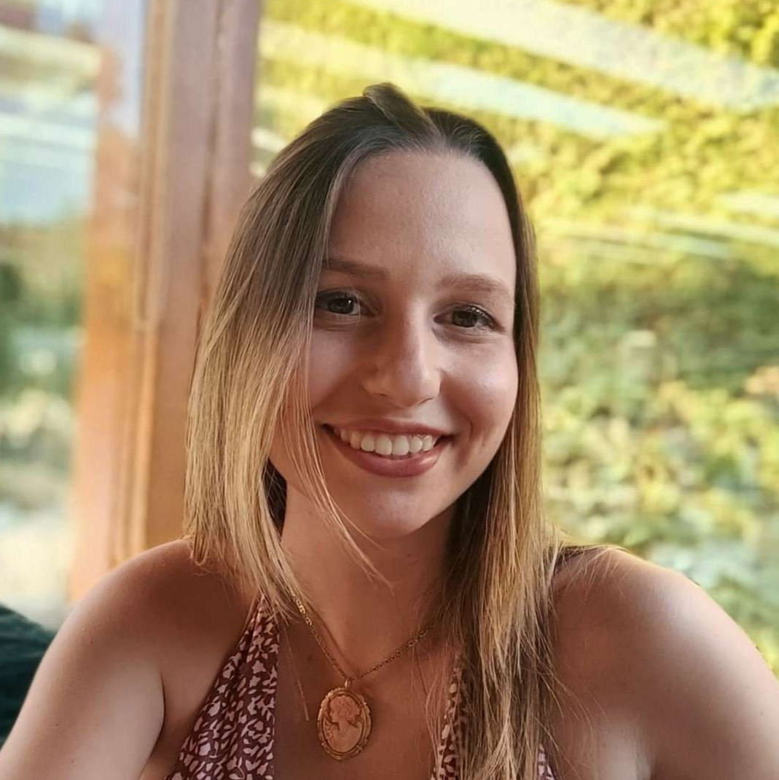
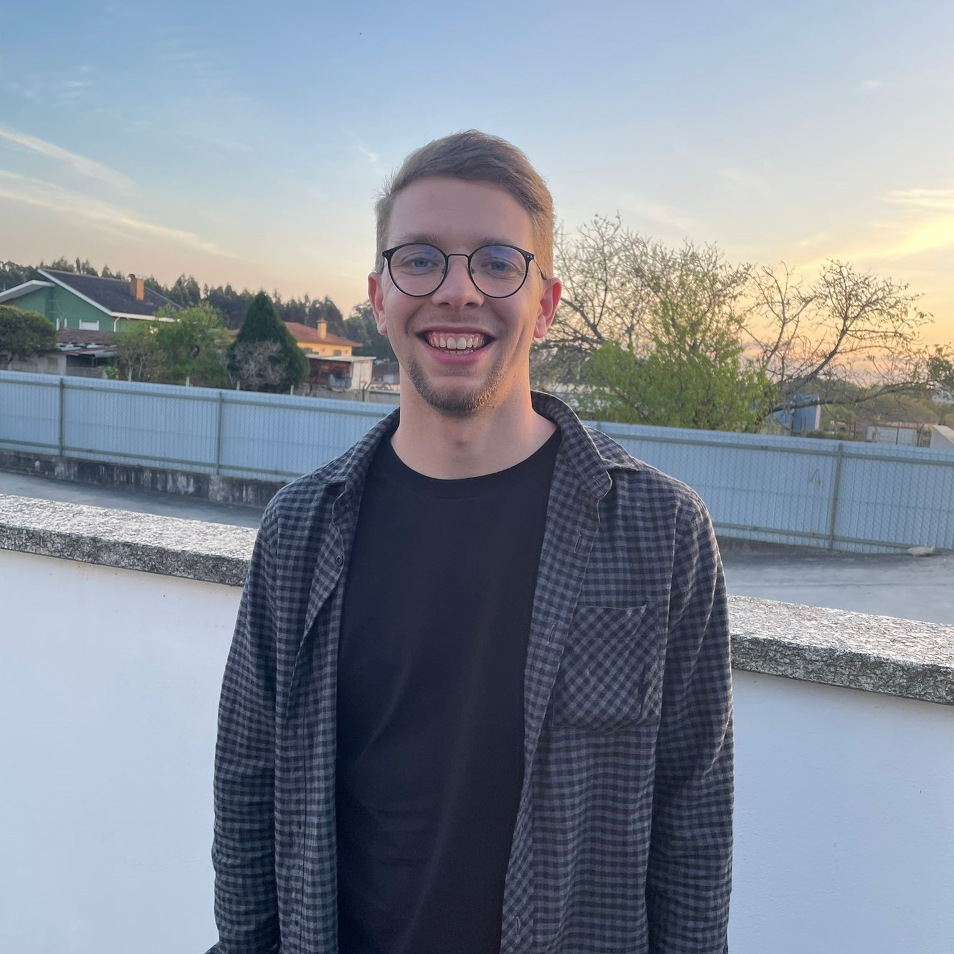
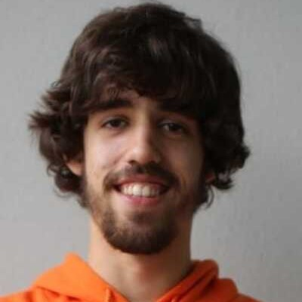

Our Team
Alberto Oliveira
Beatriz Agante
Eduarda Aires
Miguel Gomes
Pedro Gil
Ruben Lopes
Project Supervisors: Prof. Daniel Corujo, Prof. Pedro Gonçalves

Slide 4
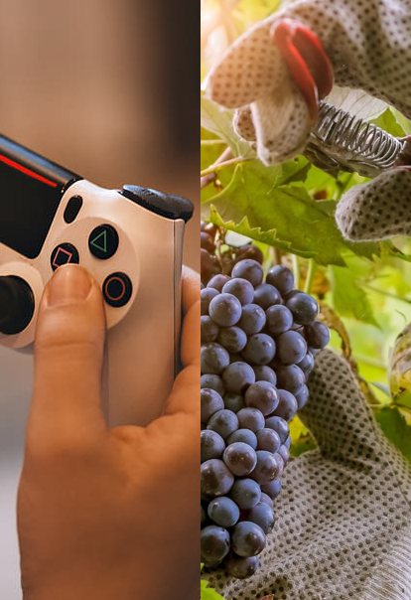
Context
Gamifying rural Portugal tourism is vital for promoting sustainability and preserving cultural and natural heritage.
Through gamification as an action-reward system, we aim to make rural tourism not only fun but also economically beneficial for local communities

Slide 5


Gamification
How does it work?
Do activities!
Spend on goodies!
Engage in various agricultural tasks: care for adorable cows, assist in gathering fruit and much more!
Utilize your earned points to redeem valuable discount coupons for an assortment of farm-related goodies!
Earn points!
Accumulate points and badges as you perform fun tasks, showcase your proficiency!

Slide 6


Motivation and Goals
Limited Awareness: Unawareness of the hidden beauty and cultural richness of rural Portugal, leading to an underutilization of these areas.
Promote the rejuvenation and social capital of rural territories.
Promote the creation of more companies in the agri-food sector and related services.

Slide 7



State of the Art
Ruralia
Explorial
Framie App
Portugal Play
What makes us different?
Focus on Urban Tourism
Our niche: Agro-tourism
Common goal: Tourism Gamification

Slide 8





System Architecture
Technologies used
Flutter
Flask
SQL
Front-End framework
Back-End framework
Database
Microservices
Docker and Kubernetes
Containers and management

Slide 9


System Architecture
UI
HTTP

Slide 10
Development
Timeline of the project
Review related work, goals and indetify stakeholders
Familiarization with micro-services (Docker and Kubernetes)
Mechanism Planning of monitorization and tracking of tourist activity
Design the architecture of software
Design and creation of Data base
Design UX/UI
Develop an app
Functional tests for app performance

Slide 11

Development
Communication and division of tasks
Tasks were assigned to groups of 2:
Front-end
Back-end: database and API
Back-end: microservices
Communication with supervisors:
Zoom meeting once per week;

Slide 12


Development
Difficulties
General unfamiliarity with microservices, requiring extra time to learn how it functions and how to apply it;
Certain tasks depended on the completion of others, which sometimes resulted in delays and additional coordination;

Slide 13
Functionalities
…for the tourist :
Create an account
to start your agro-tourism gaming journey
Explore the farm’s page, discover what they have to offer: animals, crops and activities
Scan a QR code
after an activity is complete to earn points
Discover a home page tailored to your interests, featuring recommendations of farms and activities
Spend points on vouchers for discounts on farm items
Search for nearby farms using an interactive map or search bar
Search for fun activities
to participate on and earn points

Slide 14
Functionalities
…for the farmer :
Register your farm
to join our platform and offer a gaming experience to tourists
Customize your farm’s page by adding animals and crops, let tourists know what they can find there
Create fun activities
that the tourists can complete to earn points
Generate a QR code
to award points to tourists
Create discount vouchers
to encourage tourists to buy your products

Slide 15


Demonstration

Slide 16





Future Work
Additional functionalities we would like to implement in the future:
Rating of products, farms, activities
Automation of professional account creation
Multiplayer activities
Ranking leaderboard
After-activity insights

Slide 17
Thanks!
Do you have any questions?

